Slide 1
Decision Tree

Slide 2
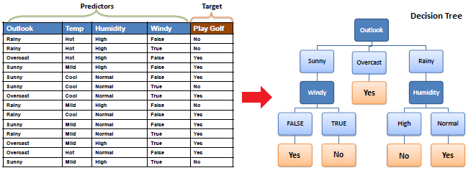
Decision Tree
A decision tree partitions the input space into mutually exclusive regions, each of which is assigned a procedure to characterize its data points
Algorithm
The core algorithm for building decision trees called ID3 by J. R. Quinlan which employs a top-down, greedy search through the space of possible branches with no backtracking. ID3 uses Entropy and Information Gain to construct a decision tree.

Slide 3
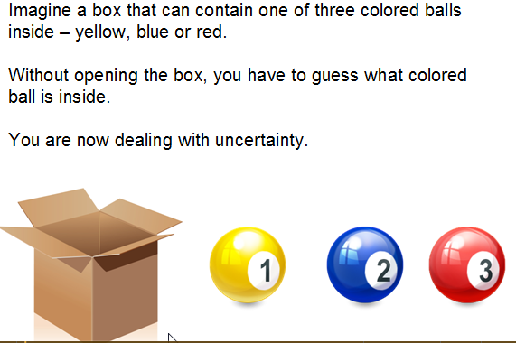
Entropy

Slide 4
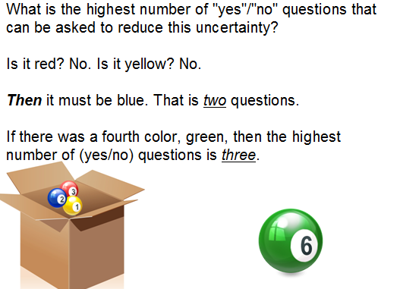
Entropy cont..

Slide 5

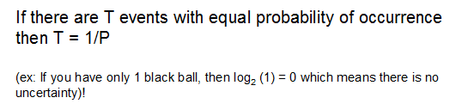
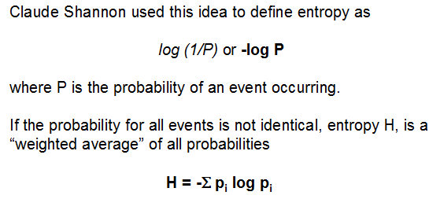
Entropy cont..

Slide 6
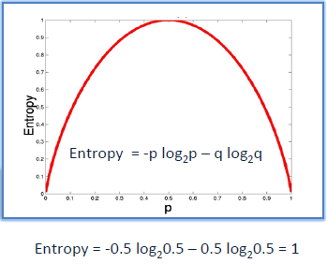
Entropy cont..
If the sample is completely homogeneous the entropy is zero and if the sample is an equally divided it has entropy of one.

Slide 7
Application of Entropy
A very common application of information entropy is in building decision trees. The main ideas behind using entropy for building a decision tree are these:
Using Shannon entropy, sort the dataset into homogenous and non-homogenous variables. Homogenous variables have low entropy and non-homogenous variables have high entropy
Weight the influence of each independent variable on the target or dependent variable using the concept of joint entropy.
Compute the information gain, which is essentially the reduction in the entropy of the target variable due to its relationship with each independent variable. This is simply the difference between the target entropy found in 1 minus the joint entropy calculated in 2.
The independent variable with the highest information gain will become the "root" or the first node on which the data set is divided.
Repeat this process for each variable for which the Shannon entropy is non-zero. If the entropy of a variable is zero, then that variable becomes a "leaf" node.

Slide 8

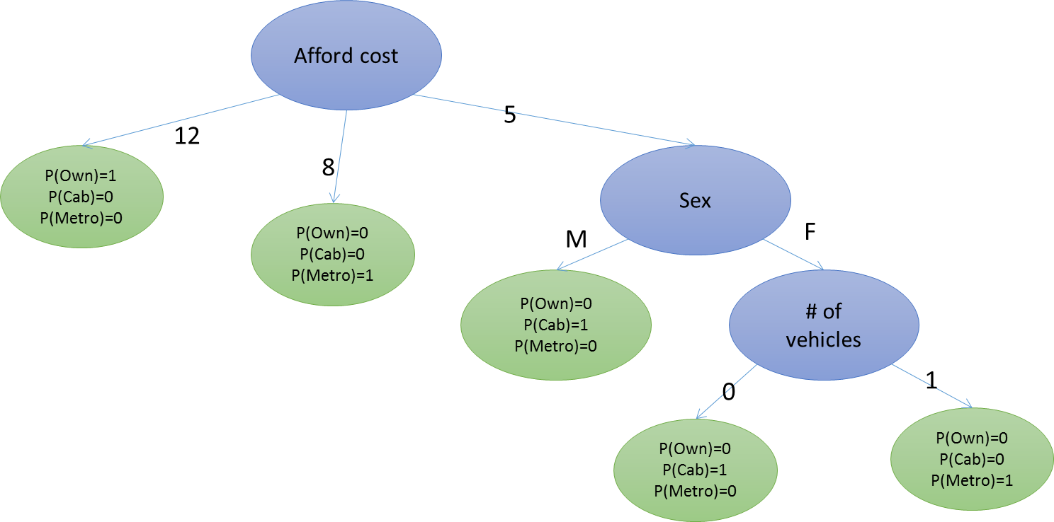
Example
Available Information
Sex | Salary | Afford cost | # of vehicles | Transport
M | 1000-3000 | 5 | 0 | Cab
M | 3000-5000 | 5 | 1 | Cab
F | 3000-5000 | 5 | 1 | Metro
F | 1000-3000 | 5 | 0 | Cab
M | 3000-5000 | 5 | 1 | Cab
M | 3000-5000 | 8 | 0 | Metro
F | 3000-5000 | 8 | 1 | Metro
F | 5000-8000 | 12 | 1 | Own
M | 3000-5000 | 12 | 2 | Own
F | 5000-8000 | 12 | 2 | Own

Slide 9
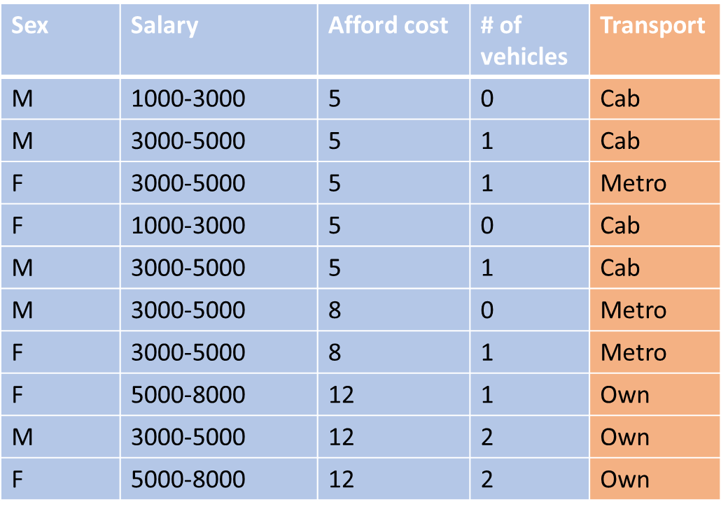

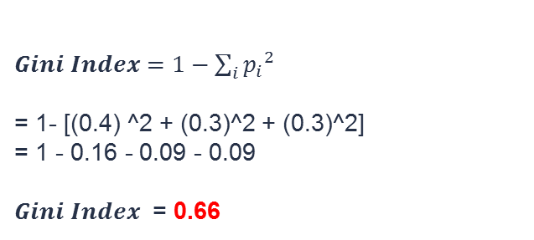

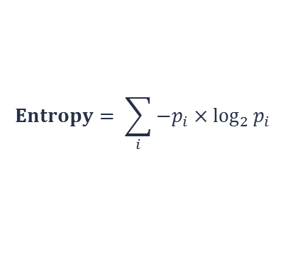


Entropy calculation
To measure Homogeneity or heterogeneity we can compute following two terms
$$Entropy= \sum_{i}{−p_{i}×\log_{2}{p_{i}}}$$
$p\left(bus\right)= \frac{4}{10}$ = 0.4
$p\left(car\right)= \frac{3}{10}$ = 0.3
$p\left(train\right)= \frac{3}{10}$ = 0.3
$Entropy=−0.4×log2\left(0.4\right)−0.3×log2\left(0.3\right)−0.3×log2\left(0.3\right)$
$Entropy$ = 1.571
$Gini Index=1−\sum_{i}{{p_{i}}^{2}}$
= 1- [(0.4) ^2 + (0.3)^2 + (0.3)^2]
= 1 - 0.16 - 0.09 - 0.09
$Gini Index$ = 0.66

Slide 10
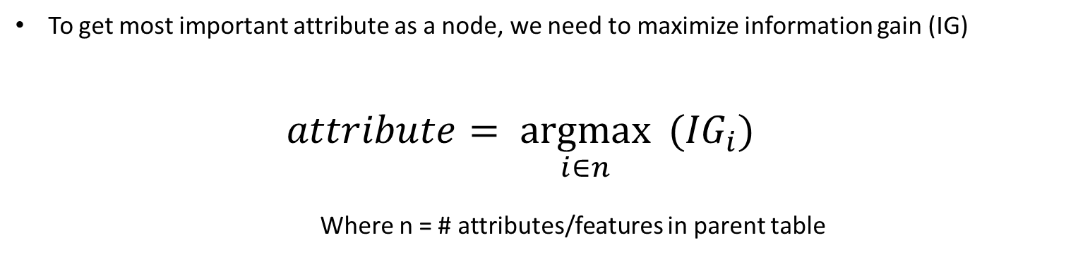
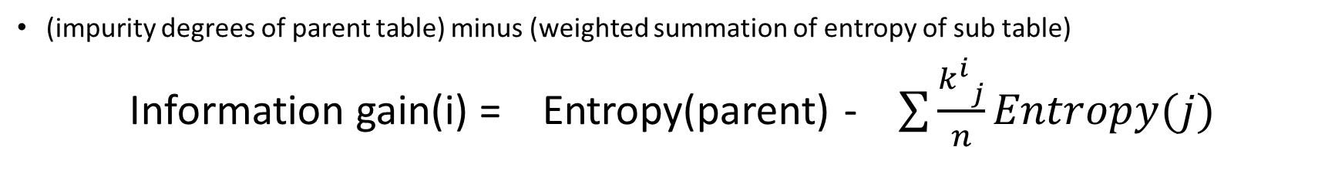
Information Gain
(impurity degrees of parent table) minus (weighted summation of entropy of sub table)
Information gain(i) = Entropy(parent) - $\sum{\frac{{k_{}^{i}}_{j}}{n}Entropy(j)}$
To get most important attribute as a node, we need to maximize information gain (IG)
$$attribute= \underset{i∈n}{argmax}{ ({IG}_{i})}$$
Where n = # attributes/features in parent table

Slide 11
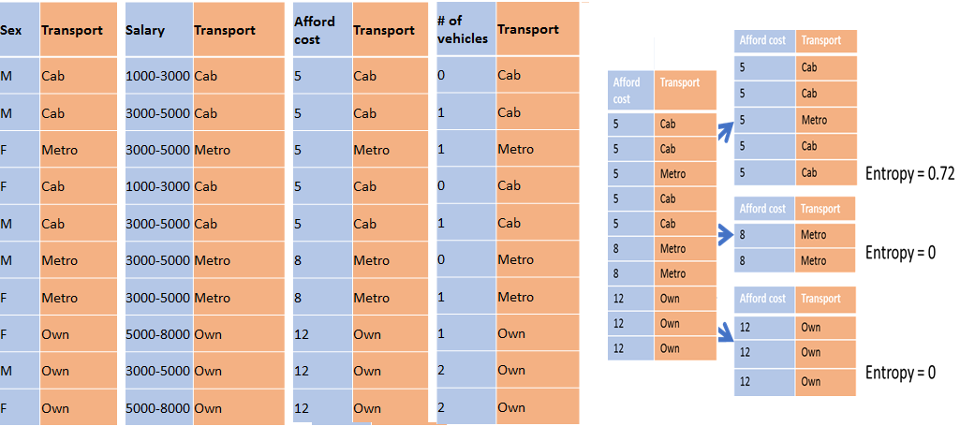
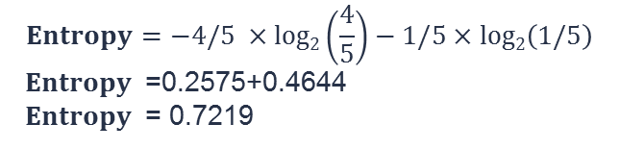
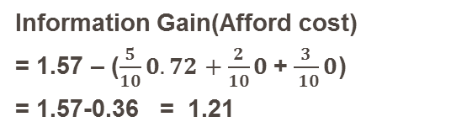
Decision Tree Growth
Information Gain(Afford cost)
= 1.57 – ($\frac{5}{10}0.72+\frac{2}{10}0$+ $\frac{3}{ 10}0$)
= 1.57-0.36 = 1.21
$$Entropy=−4/5 ×log2\left(\frac{4}{5}\right)−1/5×log2\left(1/5\right)$$
$Entropy$ =0.2575+0.4644
$Entropy$ = 0.7219

Slide 12
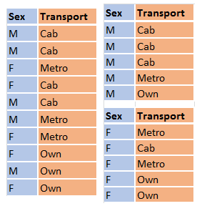
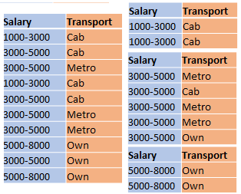
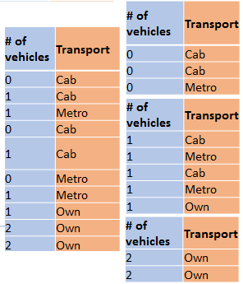
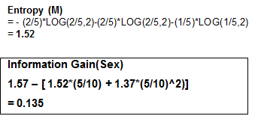
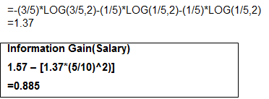
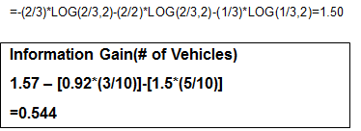
Decision Tree Growth
Information Gain (1.21) is max for Affordable Cost. Hence tree will split at Affordable cost

Slide 13
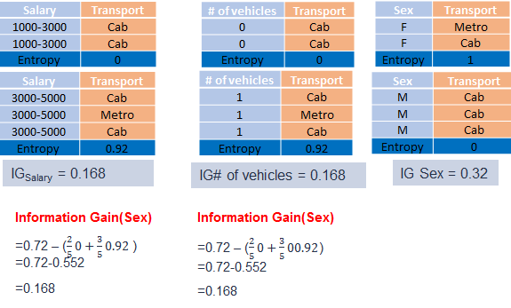
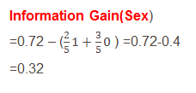
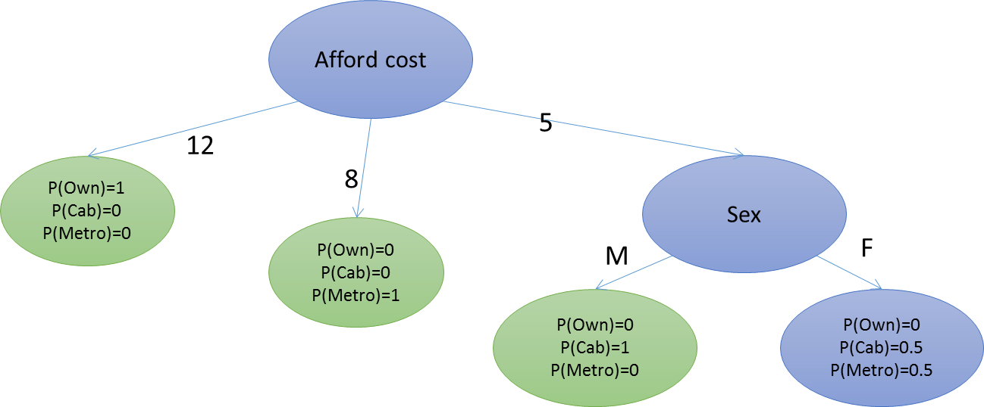
New Parent table
Sex | # of vehicles | Afford cost | Salary | Transport
M | 0 | 5 | 1000-3000 | Cab
M | 1 | 5 | 3000-5000 | Cab
F | 1 | 5 | 3000-5000 | Metro
F | 0 | 5 | 1000-3000 | Cab
M | 1 | 5 | 3000-5000 | Cab
Sex | # of vehicles | Salary | Transport
M | 0 | 1000-3000 | Cab
M | 1 | 3000-5000 | Cab
F | 1 | 3000-5000 | Metro
F | 0 | 1000-3000 | Cab
M | 1 | 3000-5000 | Cab
Second Split Happens at Sex as Information Gain is Max.

Slide 14
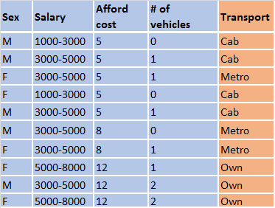
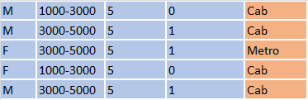




Tree Growth
Afford cost
12
8
5
P(Own)=1
P(Cab)=0
P(Metro)=0
Sex
P(Own)=0
P(Cab)=0
P(Metro)=1
M
F
P(Own)=0
P(Cab)=1
P(Metro)=0
# of vehicles
1
0
P(Own)=0
P(Cab)=1
P(Metro)=0
P(Own)=0
P(Cab)=0
P(Metro)=1

Slide 15
Advantages of using Decision Trees for predictive analytics
Advantage 1: When we fit a decision tree to a training dataset, the top few nodes on which the tree is split are essentially the most important variables within the dataset and feature selection is completed automatically!
Advantage 2: Decision trees require relatively little effort from users for data preparation To overcome scale differences between parameters - for example if we have a dataset which measures revenue in millions and loan age in years, this will require some form of normalization or scaling before we can fit a regression model and interpret the coefficients. Such variable transformations are not required with decision trees because the tree structure will remain the same with or without the transformation
Another feature which saves data prep time: missing values will not prevent splitting the data for building trees.
Decision trees are also not sensitive to outliers since the splitting happens based on proportion of samples within the split ranges and not on absolute values.
Advantage 3: Nonlinear relationships between parameters do not affect tree performance As we described here, highly nonlinear relationships between variables will result in failing checks for simple regression models and thus make such models invalid. However, decision trees do not require any assumptions of linearity in the data. Thus, we can use them in scenarios where we know the parameters are nonlinearly related.
Advantage 4: The best feature of using trees for analytics - easy to interpret and explain to executives!
However, all these advantages need to be tempered with one key disadvantage of decision trees: without proper pruning or limiting tree growth, they tend to overfit the training data, making them somewhat poor predictors.

Slide 16
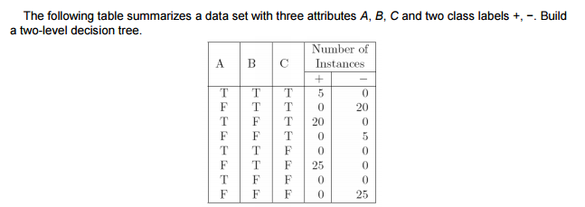
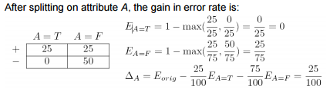
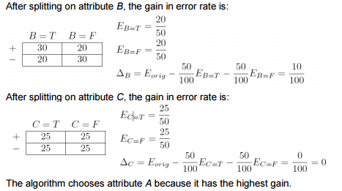
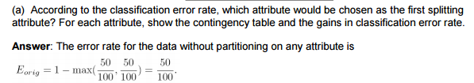
Split on Classification Error- Example

Slide 17
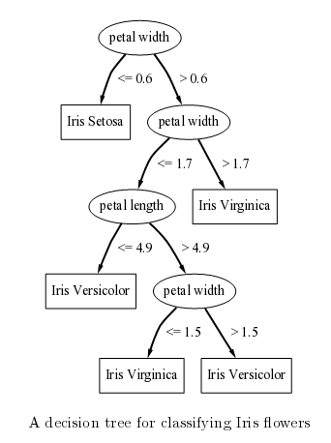
Pruning

Slide 18
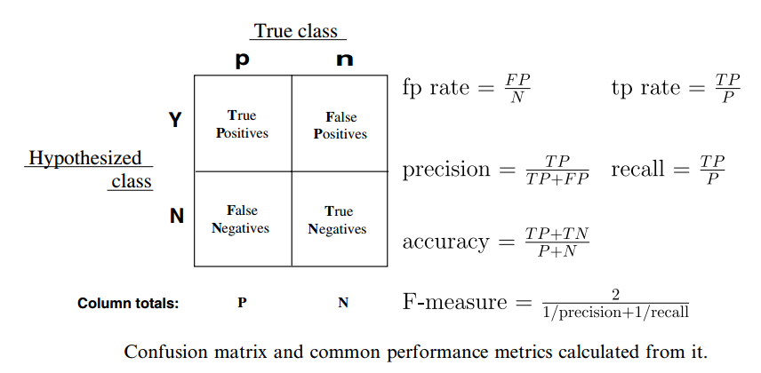
Confusion Matrix

Slide 19
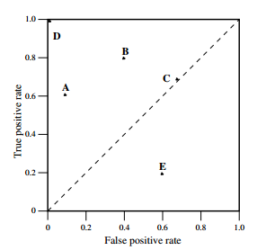
ROC curve
ROC graphs are two-dimensional graphs in which tp rate is plotted on the Y axis and fp rate is plotted on the X axis. An ROC graph depicts relative trade-offs between benefits (true positives) and costs (false positives). Fig. 2 shows an ROC graph with five classifiers labelled A through E
A discrete classifier is one that outputs only a class label. Each discrete classifier produces an (fp rate,tp rate) pair corresponding to a single point in ROC space. The classifi- ers in Fig. 2 are all discrete classifiers. Several points in ROC space are important to note. The lower left point (0, 0) represents the strategy of never issuing a positive classification; such a classifier commits no false positive errors but also gains no true positives. The opposite strategy, of unconditionally issuing positive classi- fications, is represented by the upper right point (1, 1). The point (0, 1) represents perfect classification. Ds performance is perfect as shown. Informally, one point in ROC space is better than another if it is to the northwest (tp rate is higher, fp rate is lower, or both) of the first. Classifiers appearing on the left-hand side of an ROC graph, near the X axis, may be thought of as ‘‘conservative’’: they make positive classifications only with strong evidence so they make few false positive errors, but they often have low true positive rates as well. Classifiers on the upper right-hand side of an ROC graph may be thought of as ‘‘liberal’’: they make positive classifications with weak evidence so they classify nearly all positives correctly, but they often have high false positive rates. In Fig. 2, A is more conservative than B. Many real world domains are dominated by large numbers of negative instances, so performance in the far left-hand side of the ROC graph becomes more interesting.

Slide 20
Ensemble learning
Recently there has been a lot of interest in “ensemble learning” — methods that generate many classifiers and aggregate their results.
Two well-known methods are boosting (see, e.g., Shapire et al., 1998) and bagging Breiman (1996) of classification trees.
In boosting, successive trees give extra weight to points incorrectly predicted by earlier predictors. In the end, a weighted vote is taken for prediction.
In bagging, successive trees do not depend on earlier trees — each is independently constructed using a bootstrap sample of the data set. In the end, a simple majority vote is taken for prediction
Breiman (2001) proposed random forests, which add an additional layer of randomness to bagging. In standard trees, each node is split using the best split among all variables. In a random forest, each node is split using the best among a subset of predictors randomly chosen at that node.

Slide 21
The random forests algorithm
Draw ntree bootstrap samples from the original data.
For each of the bootstrap samples, grow an unpruned classification or regression tree, with the following modification:
at each node, rather than choosing the best split among all predictors, randomly sample mtry of the predictors and choose the best split from among those variables. (Bagging can be thought of as the special case of random forests obtained when mtry = p, the number of predictors.)
Predict new data by aggregating the predictions of the ntree trees (i.e., majority votes for classification, average for regression).
An estimate of the error rate can be obtained, based on the training data, by the following:
At each bootstrap iteration, predict the data not in the bootstrap sample (what Breiman calls “out-of-bag”, or OOB, data) using the tree grown with the bootstrap sample.
Aggregate the OOB predictions. (On the average, each data point would be out-of-bag around 36% of the times, so aggregate these predictions.) Calcuate the error rate, and call it the OOB estimate of error rate.

Slide 22
Extra information from Random Forests
The randomForest package optionally produces two additional pieces of information: a measure of the importance of the predictor variables, and a measure of the internal structure of the data (the proximity of different data points to one another).
Variable importance : This is a difficult concept to define in general, because the importance of a variable may be due to its (possibly complex) interaction with other variables. The random forest algorithm estimates the importance of a variable by looking at how much prediction error increases when (OOB) data for that variable is permuted while all others are left unchanged. The necessary calculations are carried out tree by tree as the random forest is constructed.
Proximity measure : The (i, j) element of the proximity matrix produced by randomForest is the fraction of trees in which elements i and j fall in the same terminal node. The intuition is that “similar” observations should be in the same terminal nodes more often than dissimilar ones. The proximity matrix can be used R News ISSN to identify structure in the data (see Breiman, 2002) or for unsupervised learning with random forests

Slide 23
Some notes for practical use
The number of trees necessary for good performance grows with the number of predictors. The best way to determine how many trees are necessary is to compare predictions made by a forest to predictions made by a subset of a forest. When the subsets work as well as the full forest, you have enough trees.
For selecting mtry, Prof. Breiman suggests trying the default, half of the default, and twice the default, and pick the best. In our experience, the results generally do not change dramatically. Even mtry = 1 can give very good performance for some data! If one has a very large number of variables but expects only very few to be “important”, using larger mtry may give better performance.
A lot of trees are necessary to get stable estimates of variable importance and proximity. However, our experience has been that even though the variable importance measures may vary from run to run, the ranking of the importances is quite stable.

Slide 24
Some notes for practical use
For classification problems where the class frequencies are extremely unbalanced (e.g., 99% class 1 and 1% class 2), it may be necessary to change the prediction rule to other than majority votes. For example, in a two-class problem with 99% class 1 and 1% class 2, one may want to predict the 1% of the observations with largest class 2 probabilities as class 2, and use the smallest of those probabilities as threshold for prediction of test data (i.e., use the type=’prob’ argument in the predict method and threshold the second column of the output). We have routinely done this to get ROC curves. Prof. Breiman is working on a similar enhancement for his next version of random forest.
By default, the entire forest is contained in the forest component of the randomForest object. It can take up quite a bit of memory for a large data set or large number of trees. If prediction of test data is not needed, set the argument keep.forest=FALSE when running randomForest. This way, only one tree is kept in memory at any time, and thus lots of memory (and potentially execution time) can be saved.
Since the algorithm falls into the “embarrassingly parallel” category, one can run several random forests on different machines and then aggregate the votes component to get the final result.

Slide 25
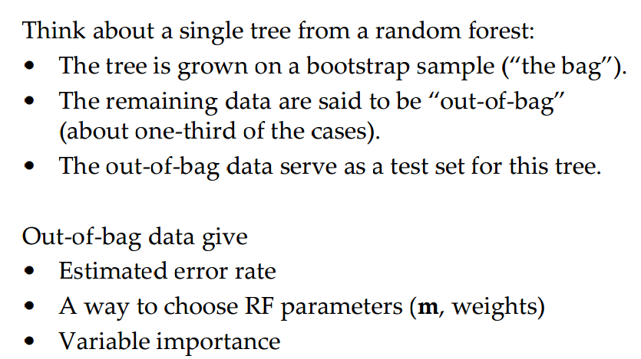
Out of Bag Data

Slide 26
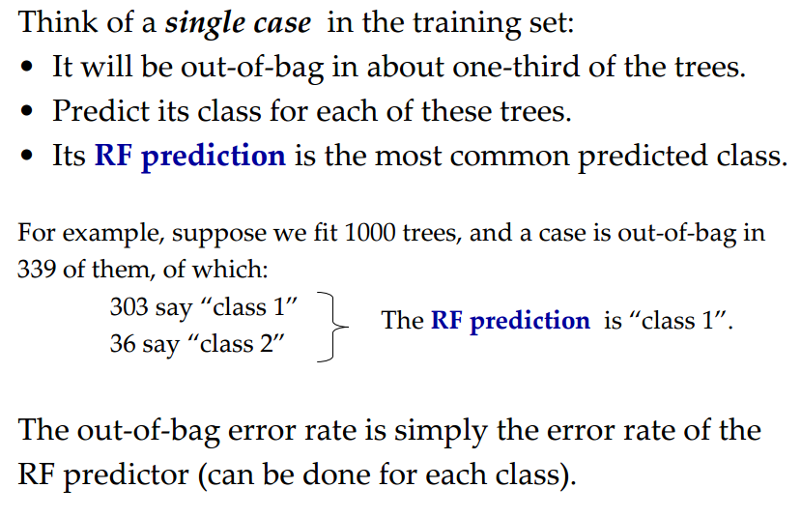
Out of Bag Error Rate

Slide 27
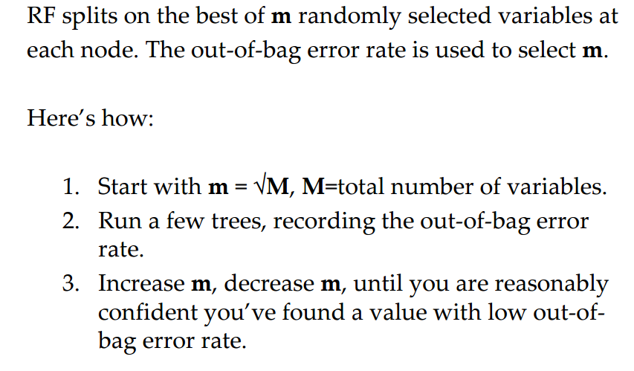
Using oob data to choose m

Slide 28
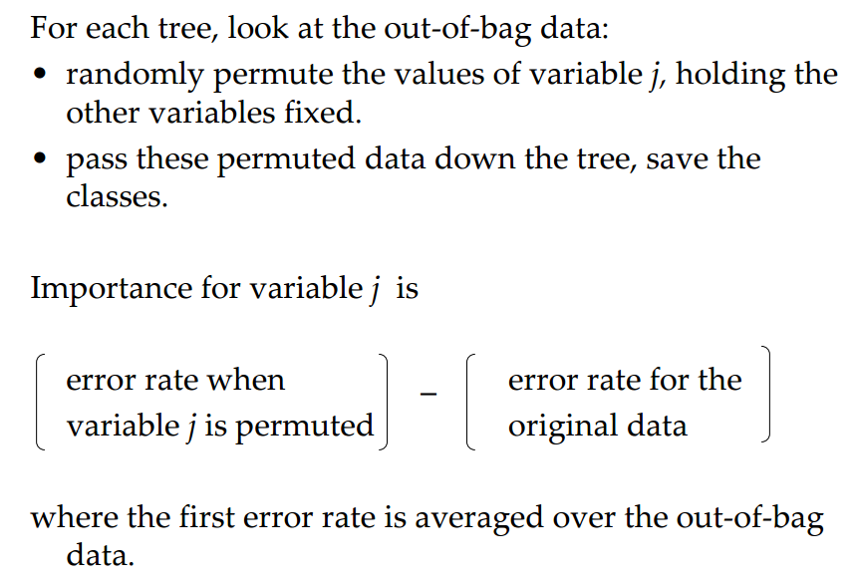
Variable Importance

Slide 29
Classification Trees and Regression Trees
Primarily there are two fundamental differences between the classification and regression trees.
The classification tree splits the response variable into mainly two classes Yes or No, also can be numerically categorized as 1 or 0. To apply recursive partitioning on the target category that can contain multiple variables, C4.5 algorithm is leveraged. In case of simple binary splits, CART algorithm is used. This is the reason why classification tree is applied when there is a need for categorical variable for categorical outcome.
The regression trees are leveraged in case where the response variable is either continuous or numeric, but not categorical. Regression trees can be applied in case of prices, quantities, or data involving quantities etc.

Slide 30
Cubist
Cubist is a rule-based model that is an extension of Quinlan's M5 model tree.
A tree is grown where the terminal leaves contain linear regression models.
These models are based on the predictors used in previous splits.
Also, there are intermediate linear models at each step of the tree.
A prediction is made using the linear regression model at the terminal node of the tree, but is "smoothed" by taking into account the prediction from the linear model in the previous node of the tree (which also occurs recursively up the tree).
The tree is reduced to a set of rules, which initially are paths from the top of the tree to the bottom.
Rules are eliminated via pruning and/or combined for simplification.

Slide 31
> library(Cubist)
> library(mlbench)
> data(BostonHousing)
> BostonHousing$chas <- as.numeric(BostonHousing$chas) - 1
> set.seed(1)
> inTrain <- sample(1:nrow(BostonHousing), floor(.8*nrow(BostonHousing)))
> trainingPredictors <- BostonHousing[ inTrain, -14] > testPredictors <- BostonHousing[-inTrain, -14]
> trainingOutcome <- BostonHousing$medv[ inTrain] > testOutcome <- BostonHousing$medv[-inTrain]
> modelTree <- cubist(x = trainingPredictors, y = trainingOutcome)
> modelTree
There is no formula method for cubist; the predictors are specified as matrix or data frame and the outcome is a numeric vector.
> mtPred <- predict(modelTree, testPredictors)
> ## Test set RMSE
> sqrt(mean((mtPred - testOutcome)^2))
[1] 3.337924 >
> ## Test set R^2
> cor(mtPred, testOutcome)^2
[1] 0.8573504

Slide 32
Ensembles By Committees
Ensembles By Committees: The Cubist model can also use a boosting–like scheme called committees where iterative model trees are created in sequence.
The first tree follows the procedure described in the last section.
Subsequent trees are created using adjusted versions to the training set outcome:
if the model over–predicted a value, the response is adjusted downward for the next model (and so on).
the final prediction is a simple average of the predictions from each model tree.
The committee option can be used to control number of model trees:
> set.seed(1)
> committeeModel <- cubist(x = trainingPredictors, y = trainingOutcome, + committees = 5)
> summary(committeeModel)

Slide 33
Instance–Based Corrections Another innovation in Cubist using nearest–neighbors to adjust the predictions from the rule–based model.
First, a model tree (with or without committees) is created.
Once a sample is predicted by this model, Cubist can find it’s nearest neighbors and determine the average of these training set points.
See Quinlan (1993a) for the details of the adjustment.

Slide 34
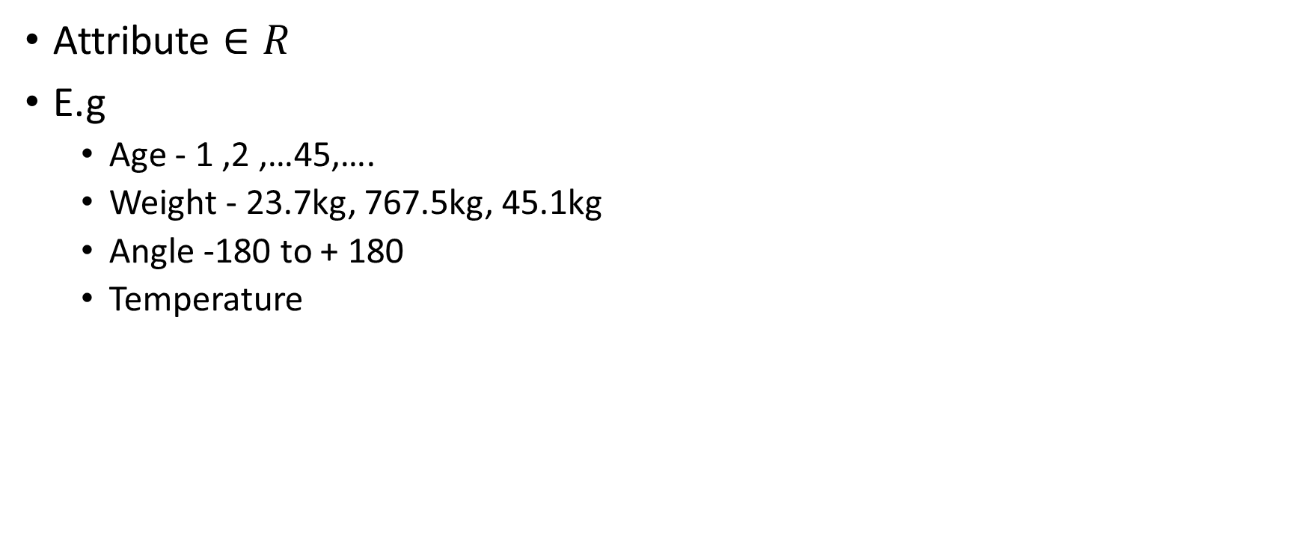
Continuous Attributes
Attribute $∈R$
E.g
Age - 1 ,2 ,…45,….
Weight - 23.7kg, 767.5kg, 45.1kg
Angle -180 to + 180
Temperature

Slide 35
How will be tree look like?
x1 < th1
x2
true
false
P(+) = 1
P(-) = 0
X2 < th2
th2
false
true
X2 < th3
P(+) = 1
P(-) = 0
th3
true
false
th5
X1 < th4
P(+) = 0
P(-) = 1
true
false
X2 < th5
P(+) = 0
P(-) = 1
true
false
P(+) = 1
P(-) = 0
P(+) = 0
P(-) = 1
th1
th4
x1

Slide 36

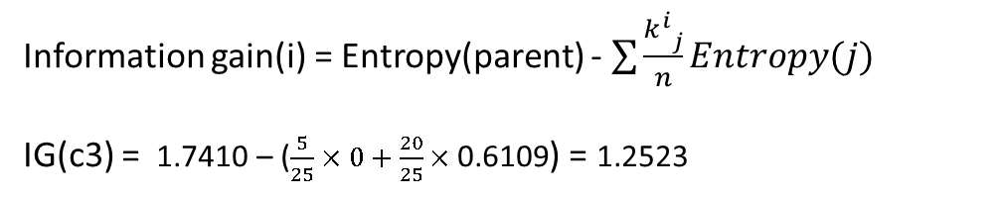

How to split node?
C = $\underset{∀i}{argmax}{{IG}^{i}}$
x2
Entropy(parent)= - $\frac{11}{25}\log\left(\frac{11}{25}\right)−\frac{14}{25}log(\frac{14}{25}$)= 1.7410
 | X1<c3 | X1>c3
P(+) | 5/5 | 6/20
P(-) | 0/5 | 14/20
Entropy | 0 | 0.6109
c11
c10
c9
c8
Information gain(i) = Entropy(parent) - $\sum{\frac{{k_{}^{i}}_{j}}{n}Entropy(j)}$
IG(c3) = 1.7410 – ($\frac{5}{25}×0+\frac{20}{25}×\text{0.6109}$) = 1.2523
c1
c2
c3
c4
c5
c6
c7
x1
IG(c1) =
…….
IG(c11) =

Slide 37
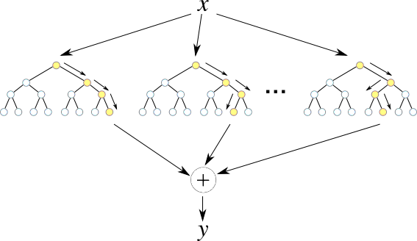
Random Forest
http://cdn-ak.f.st-hatena.com/images/fotolife/k/kazoo04/20131204/20131204173330.png

Slide 38
Random Forest
Given a Metroing set X = x₁, ..., x_{n} with responsesY = y₁, ..., y_{n}, bagging repeatedly (B times) selects a random sample with replacement of the Metroing set and fits trees to these samples:
For b = 1, ..., B:Sample, with replacement, n Metroing examples from X, Y; call these X_{b}, Y_{b}.
Metro a decision or regression tree f_{b} on X_{b}, Y_{b}.
After Metroing, predictions for unseen samples x' can be made by averaging the predictions from all the individual regression trees on x‘ or by taking the majority vote in the case of decision trees.
https://en.wikipedia.org/wiki/Random_forest

Slide 39
Reference
R. Quinlan, "Learning efficient classification procedures", Machine Learning: an artificial intelligence approach, Michalski, Carbonell & Mitchell (eds.), Morgan Kaufmann, 1983, p. 463-482
Ho, Tin Kam (1995). Random Decision Forests Proceedings of the 3rd International Conference on Document Analysis and Recognition, Montreal, QC, 14–16 August 1995. pp. 278–282.

Slide 40
